Slide 2
Notes:
Our Colorado Roots

Slide 3
Notes:
Taken those beliefs to the United Nations and the world

Slide 4
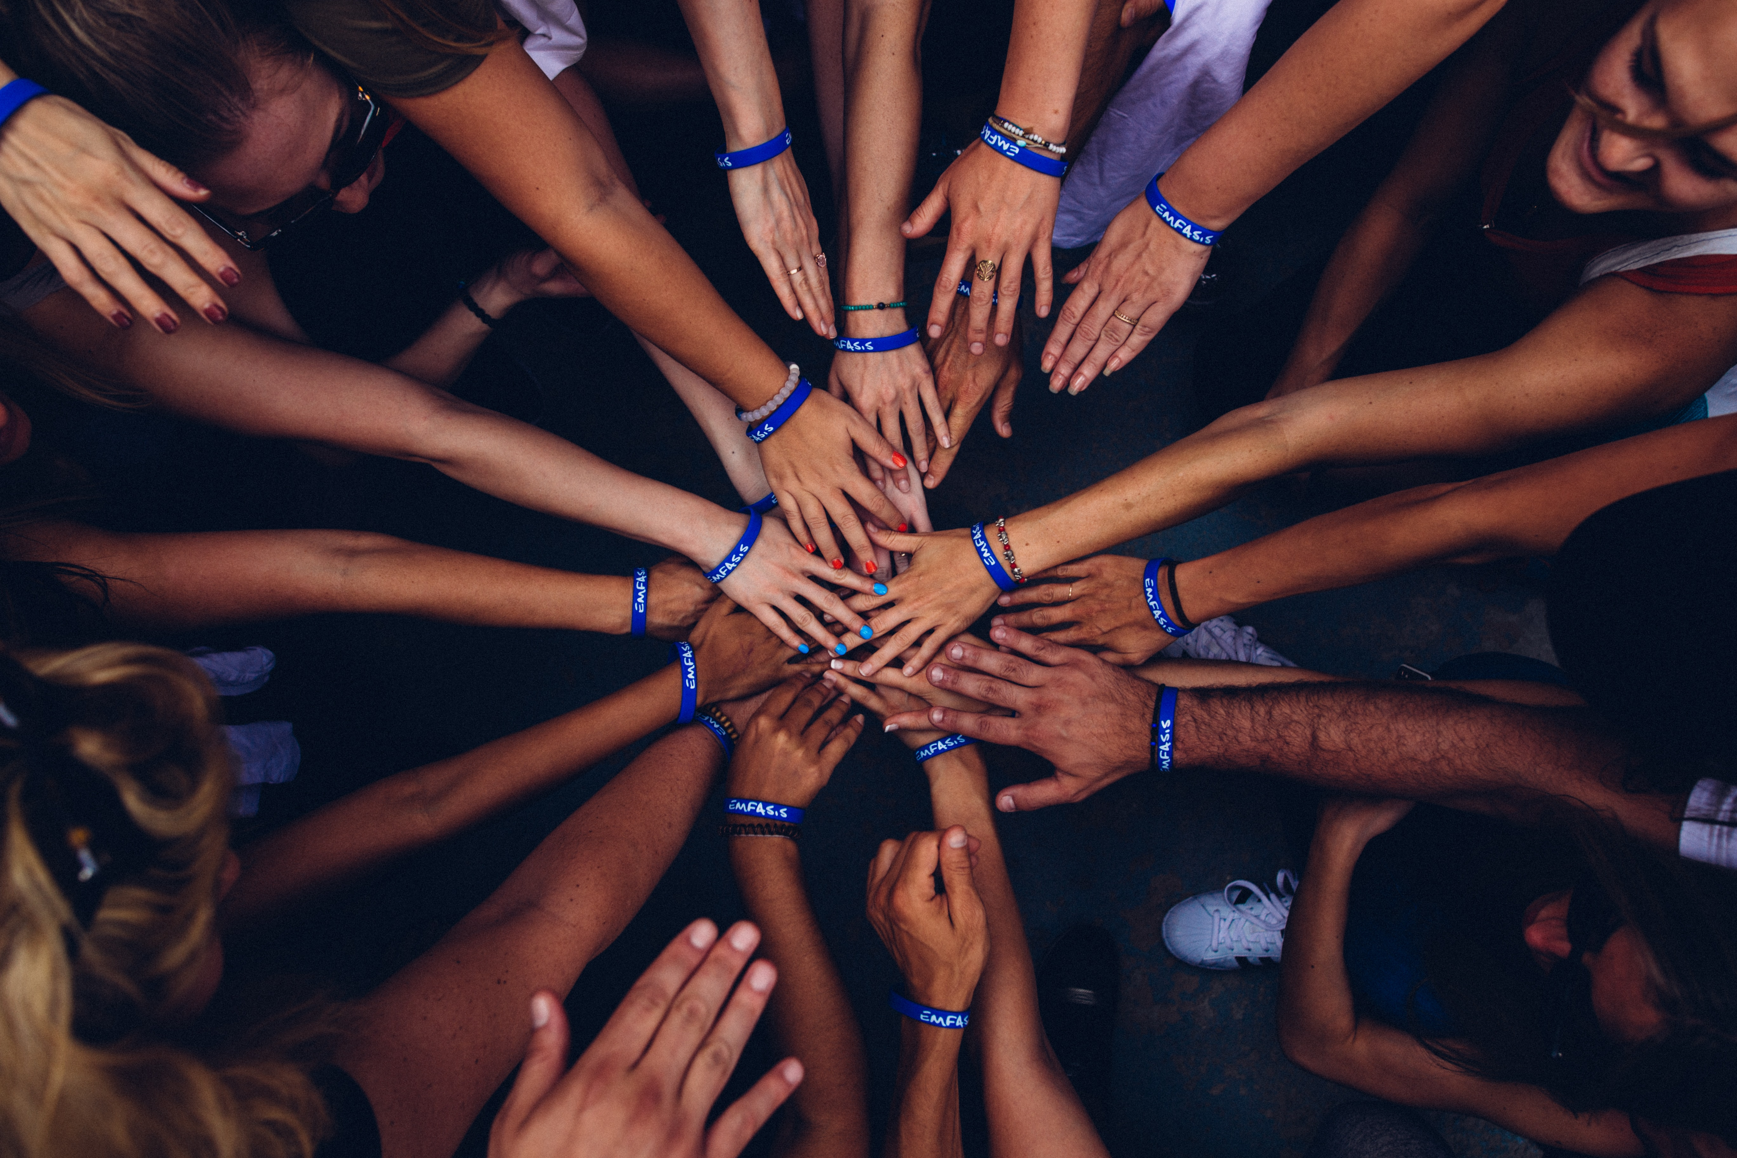
Notes:
We aren’t here to talk about community

Slide 5
Notes:
Winter is coming

Slide 6
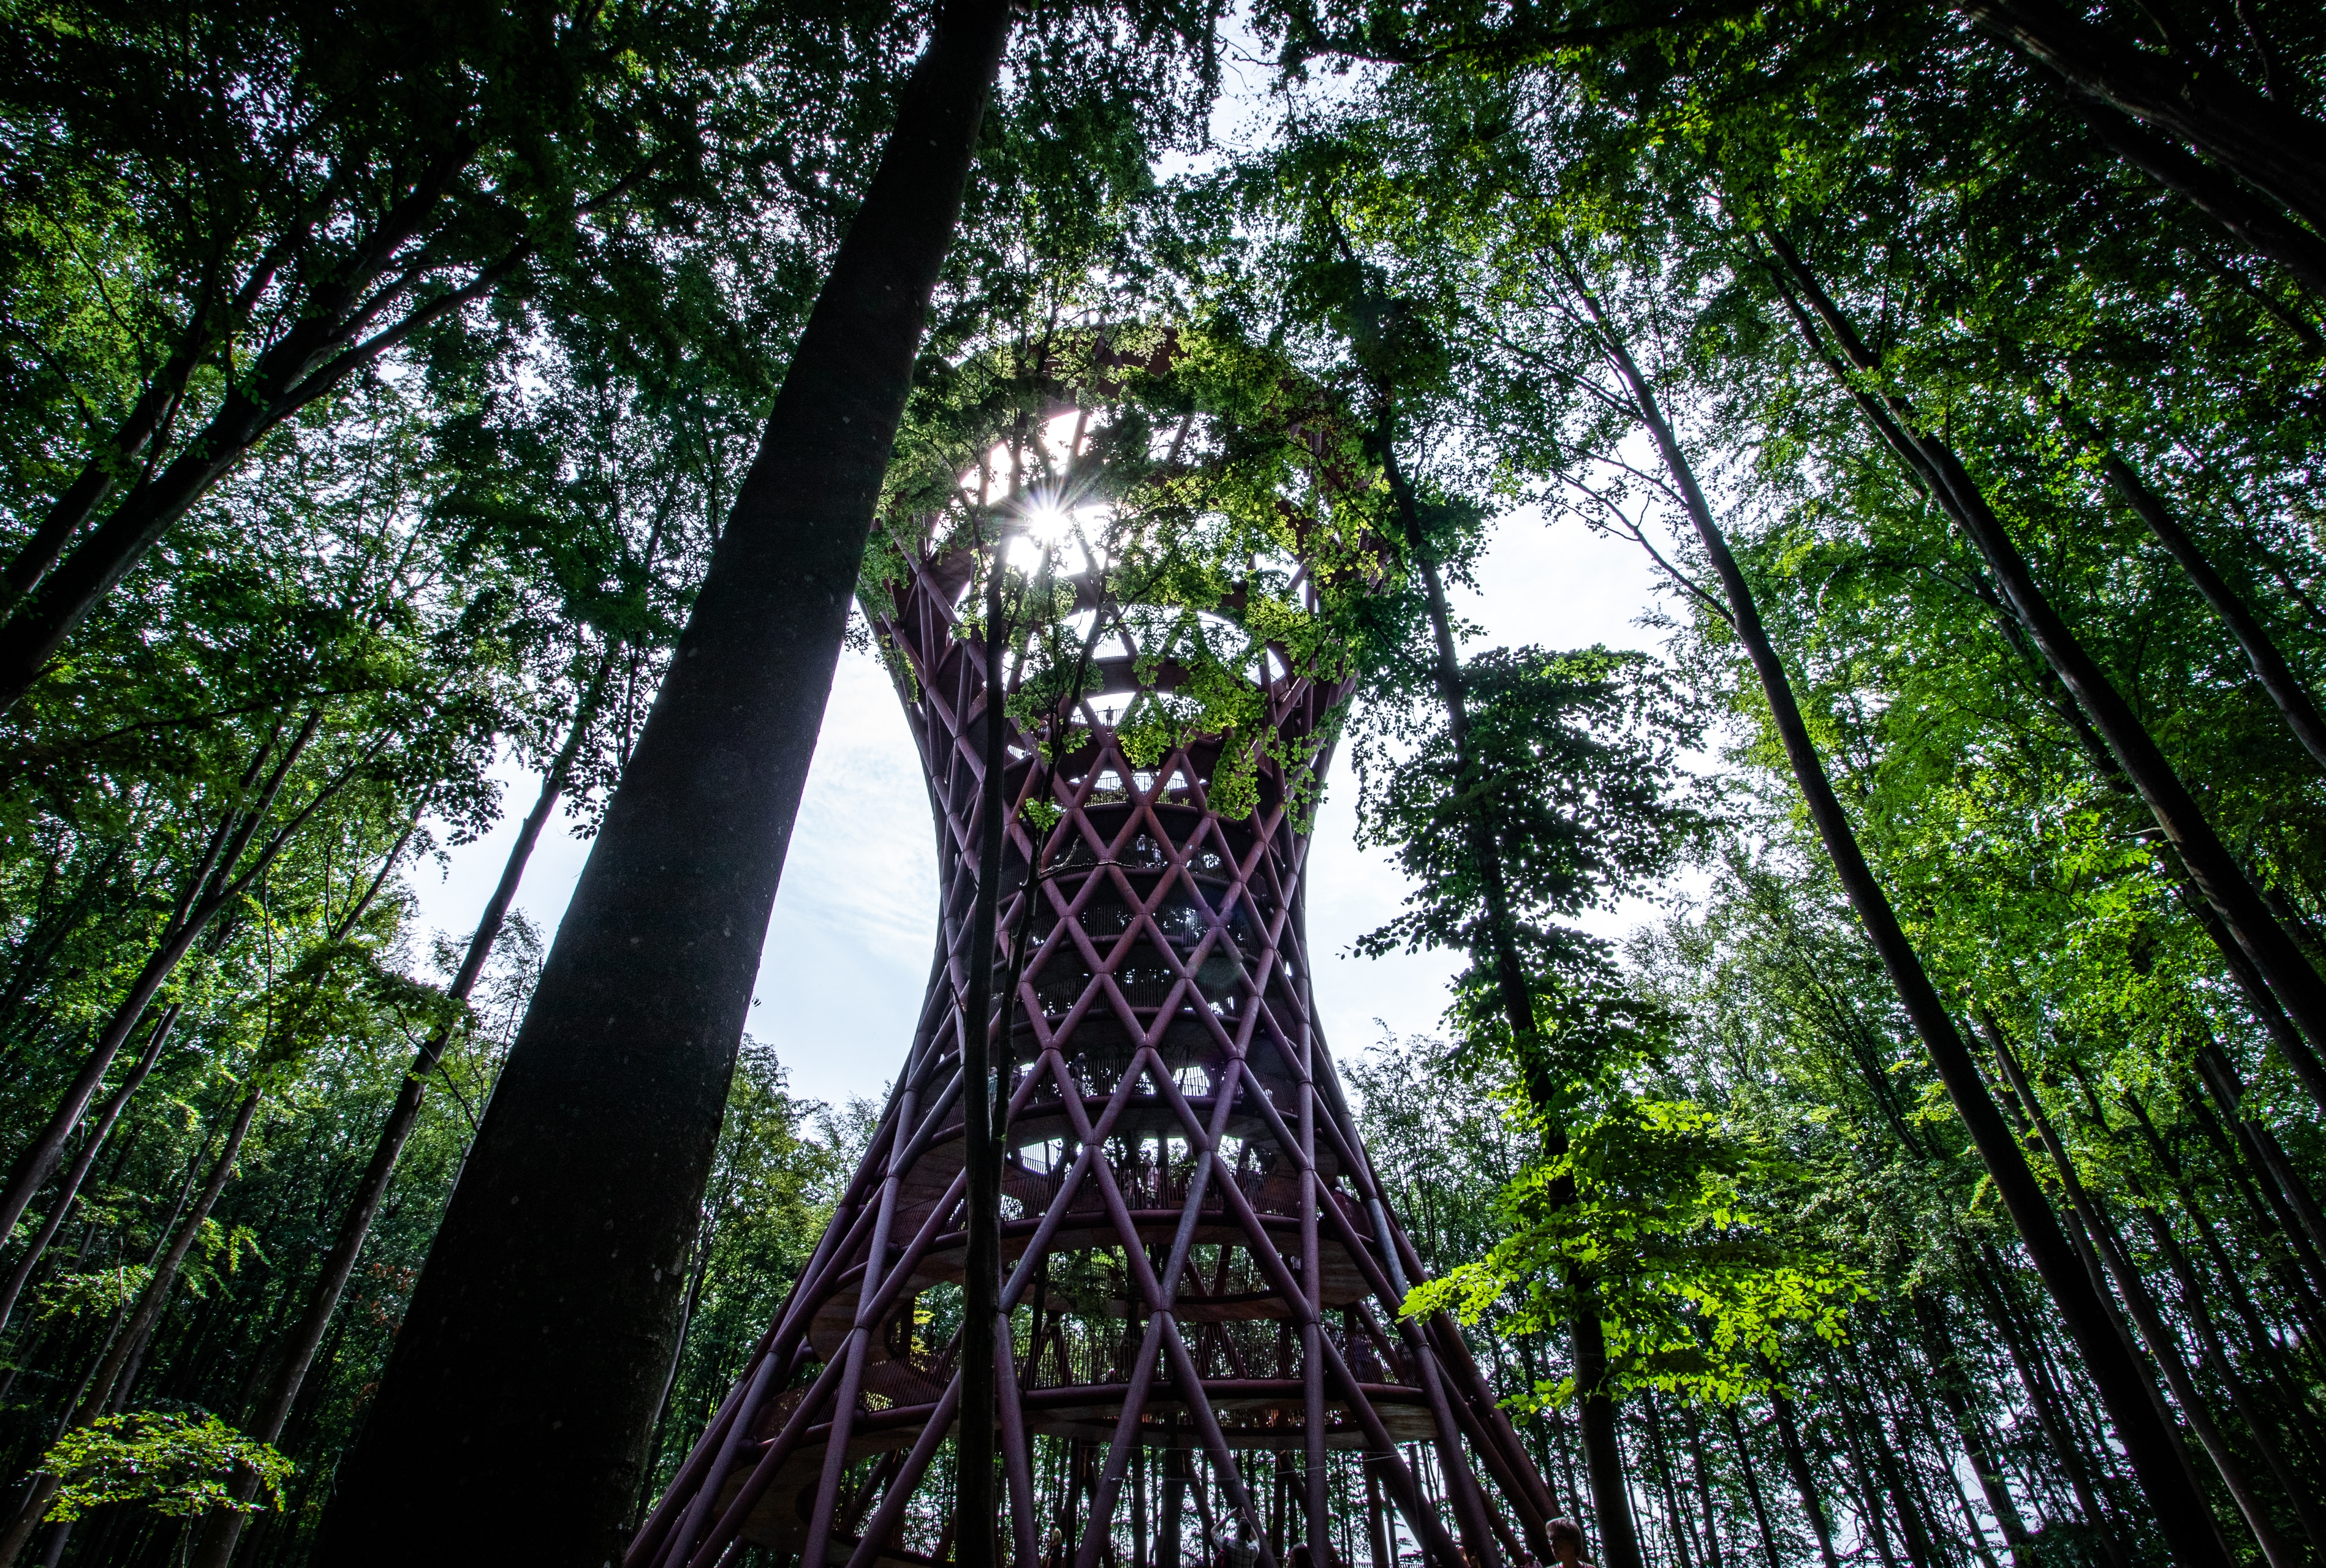
Notes:
We don’t get to do this in utopia

Slide 7
Notes:
We get to do it here.

Slide 8
Notes:
John Mackey and Paul Polman

Slide 9
Notes:
Workshop

Slide 10
What
How
Notes:
Move from making social impact a what we do to how we do it.

