Slide 1
Environmental Sustainability: Building Toward a Triple Bottom Line
Pete Dignan
Adjunct Instructor
Notes:
Start my stopwatch/timer

Slide 2
CSR?

Slide 3
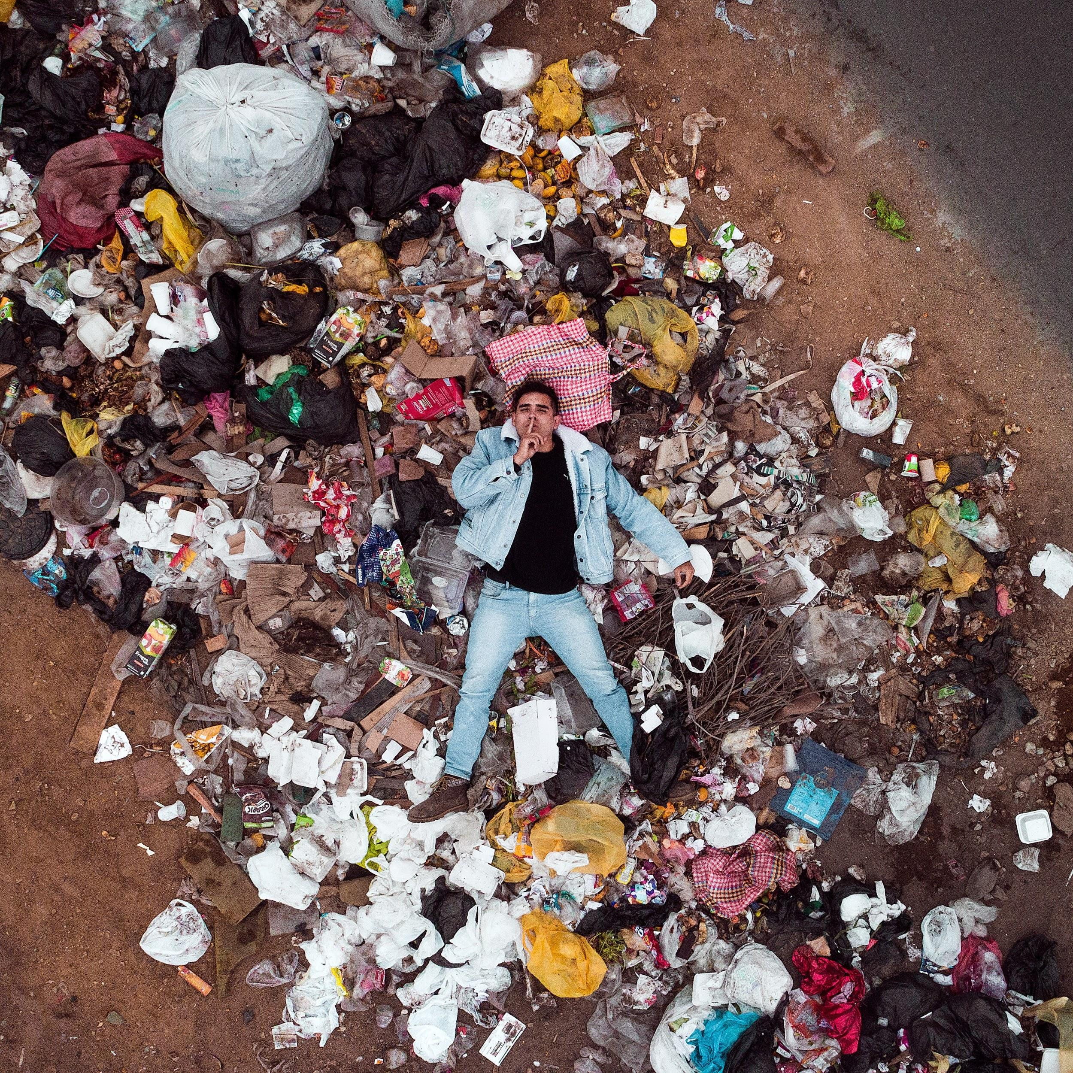
Environmental issues are people issues
Photo by Jordan Beltran on Unsplash

Slide 4
But wait, isn’t legal compliance enough?
Photo by Bruce Hong on Unsplash

Slide 5
Something is off in Accounting...
Photo by StellrWeb on Unsplash

Slide 6
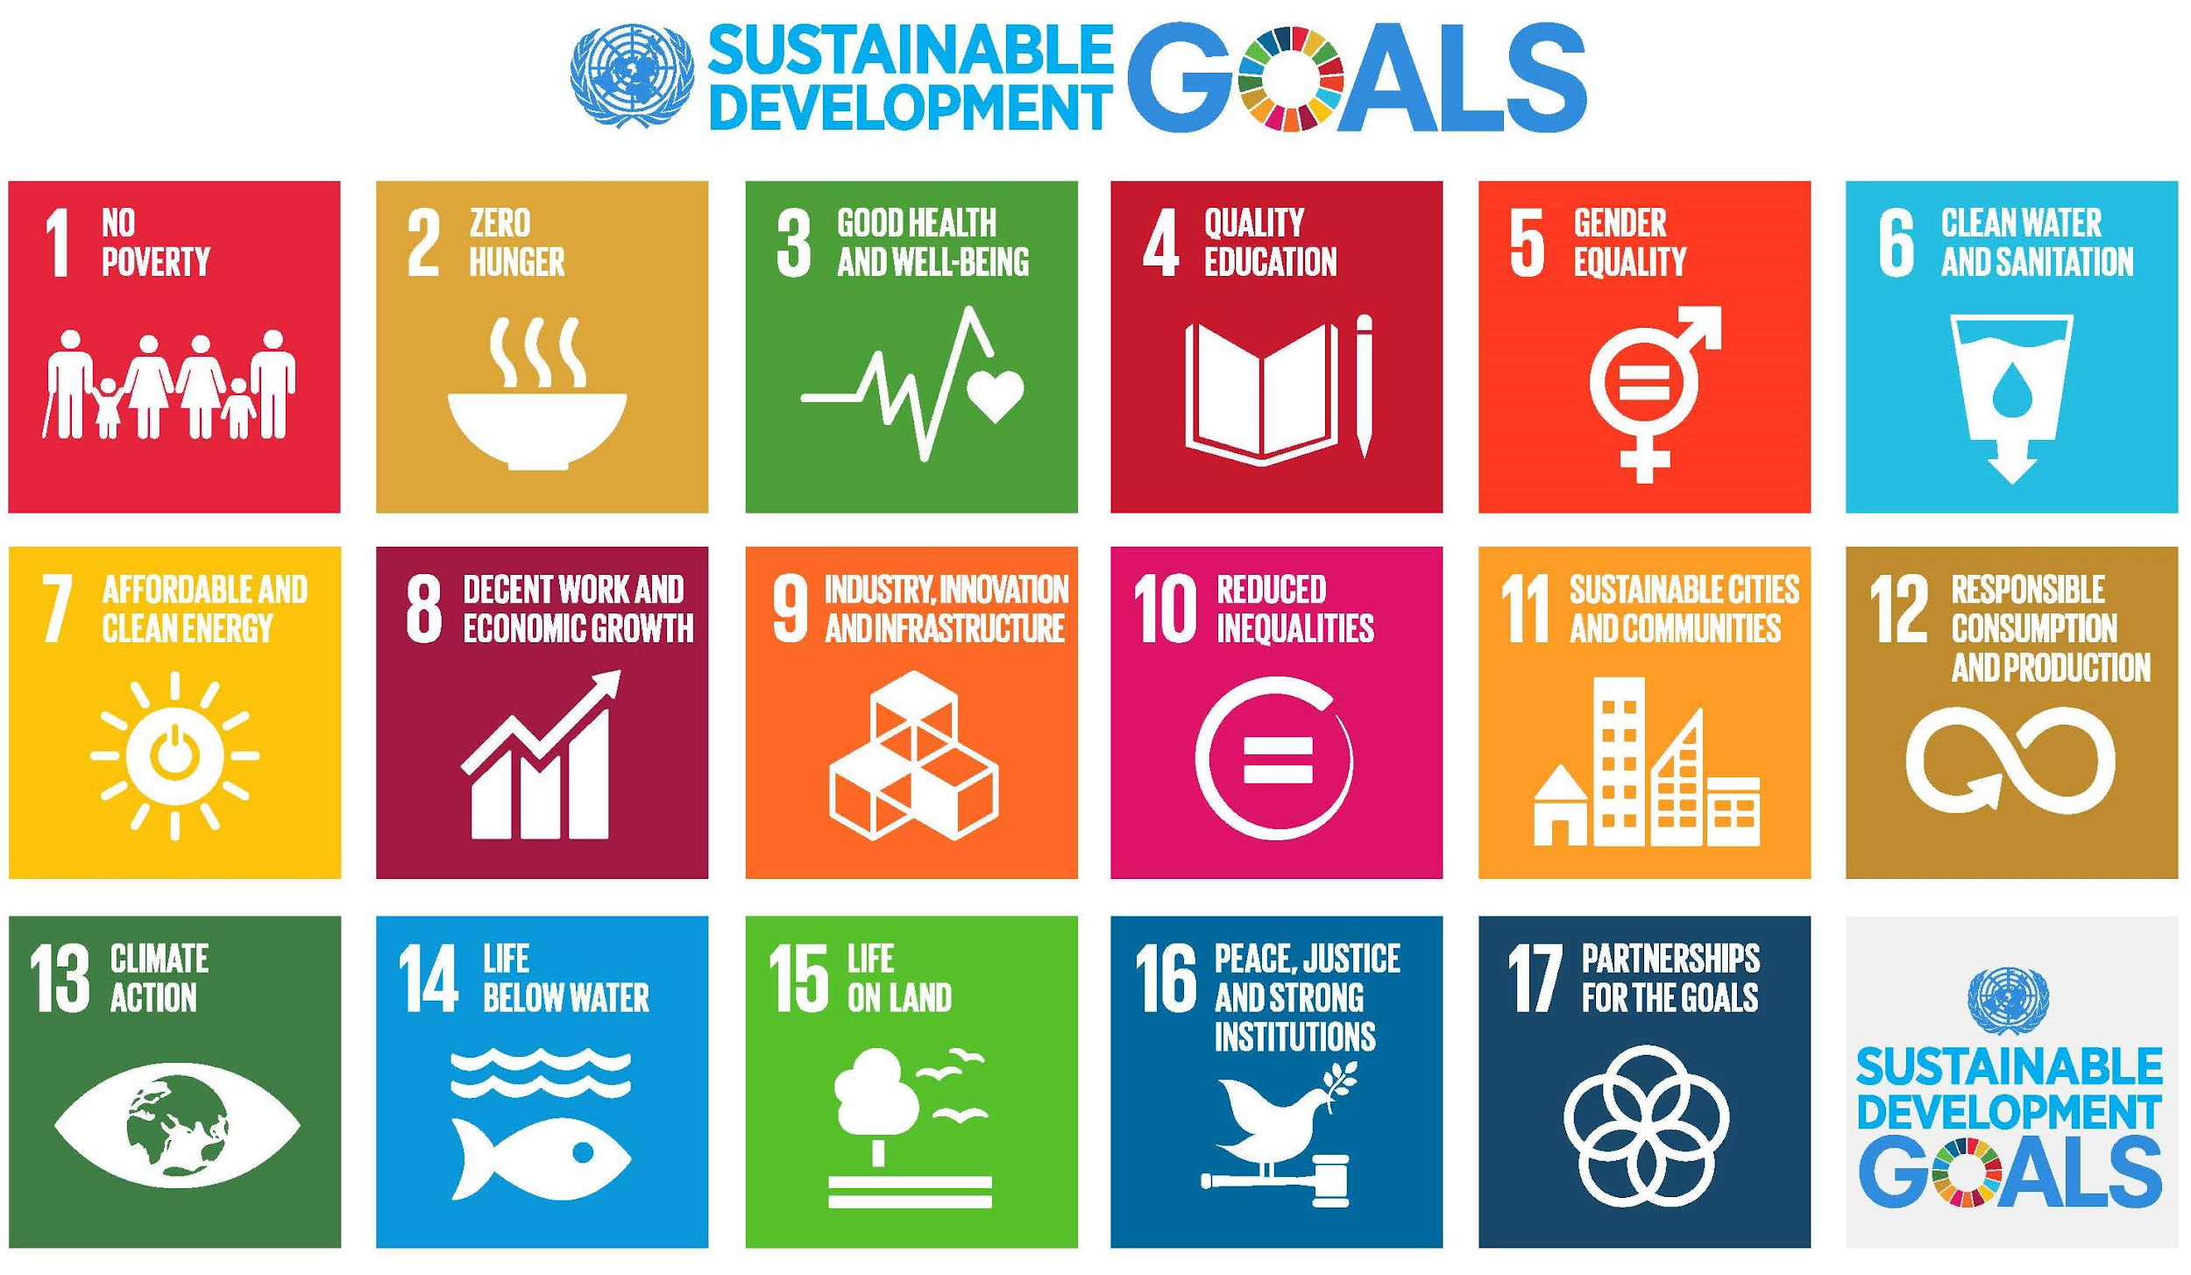
https://www.undp.org/content/undp/en/home/sustainable-development-goals/

Slide 7
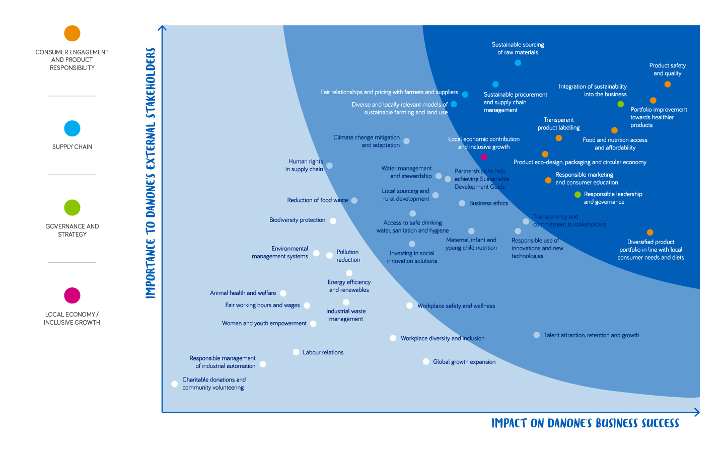

Slide 8
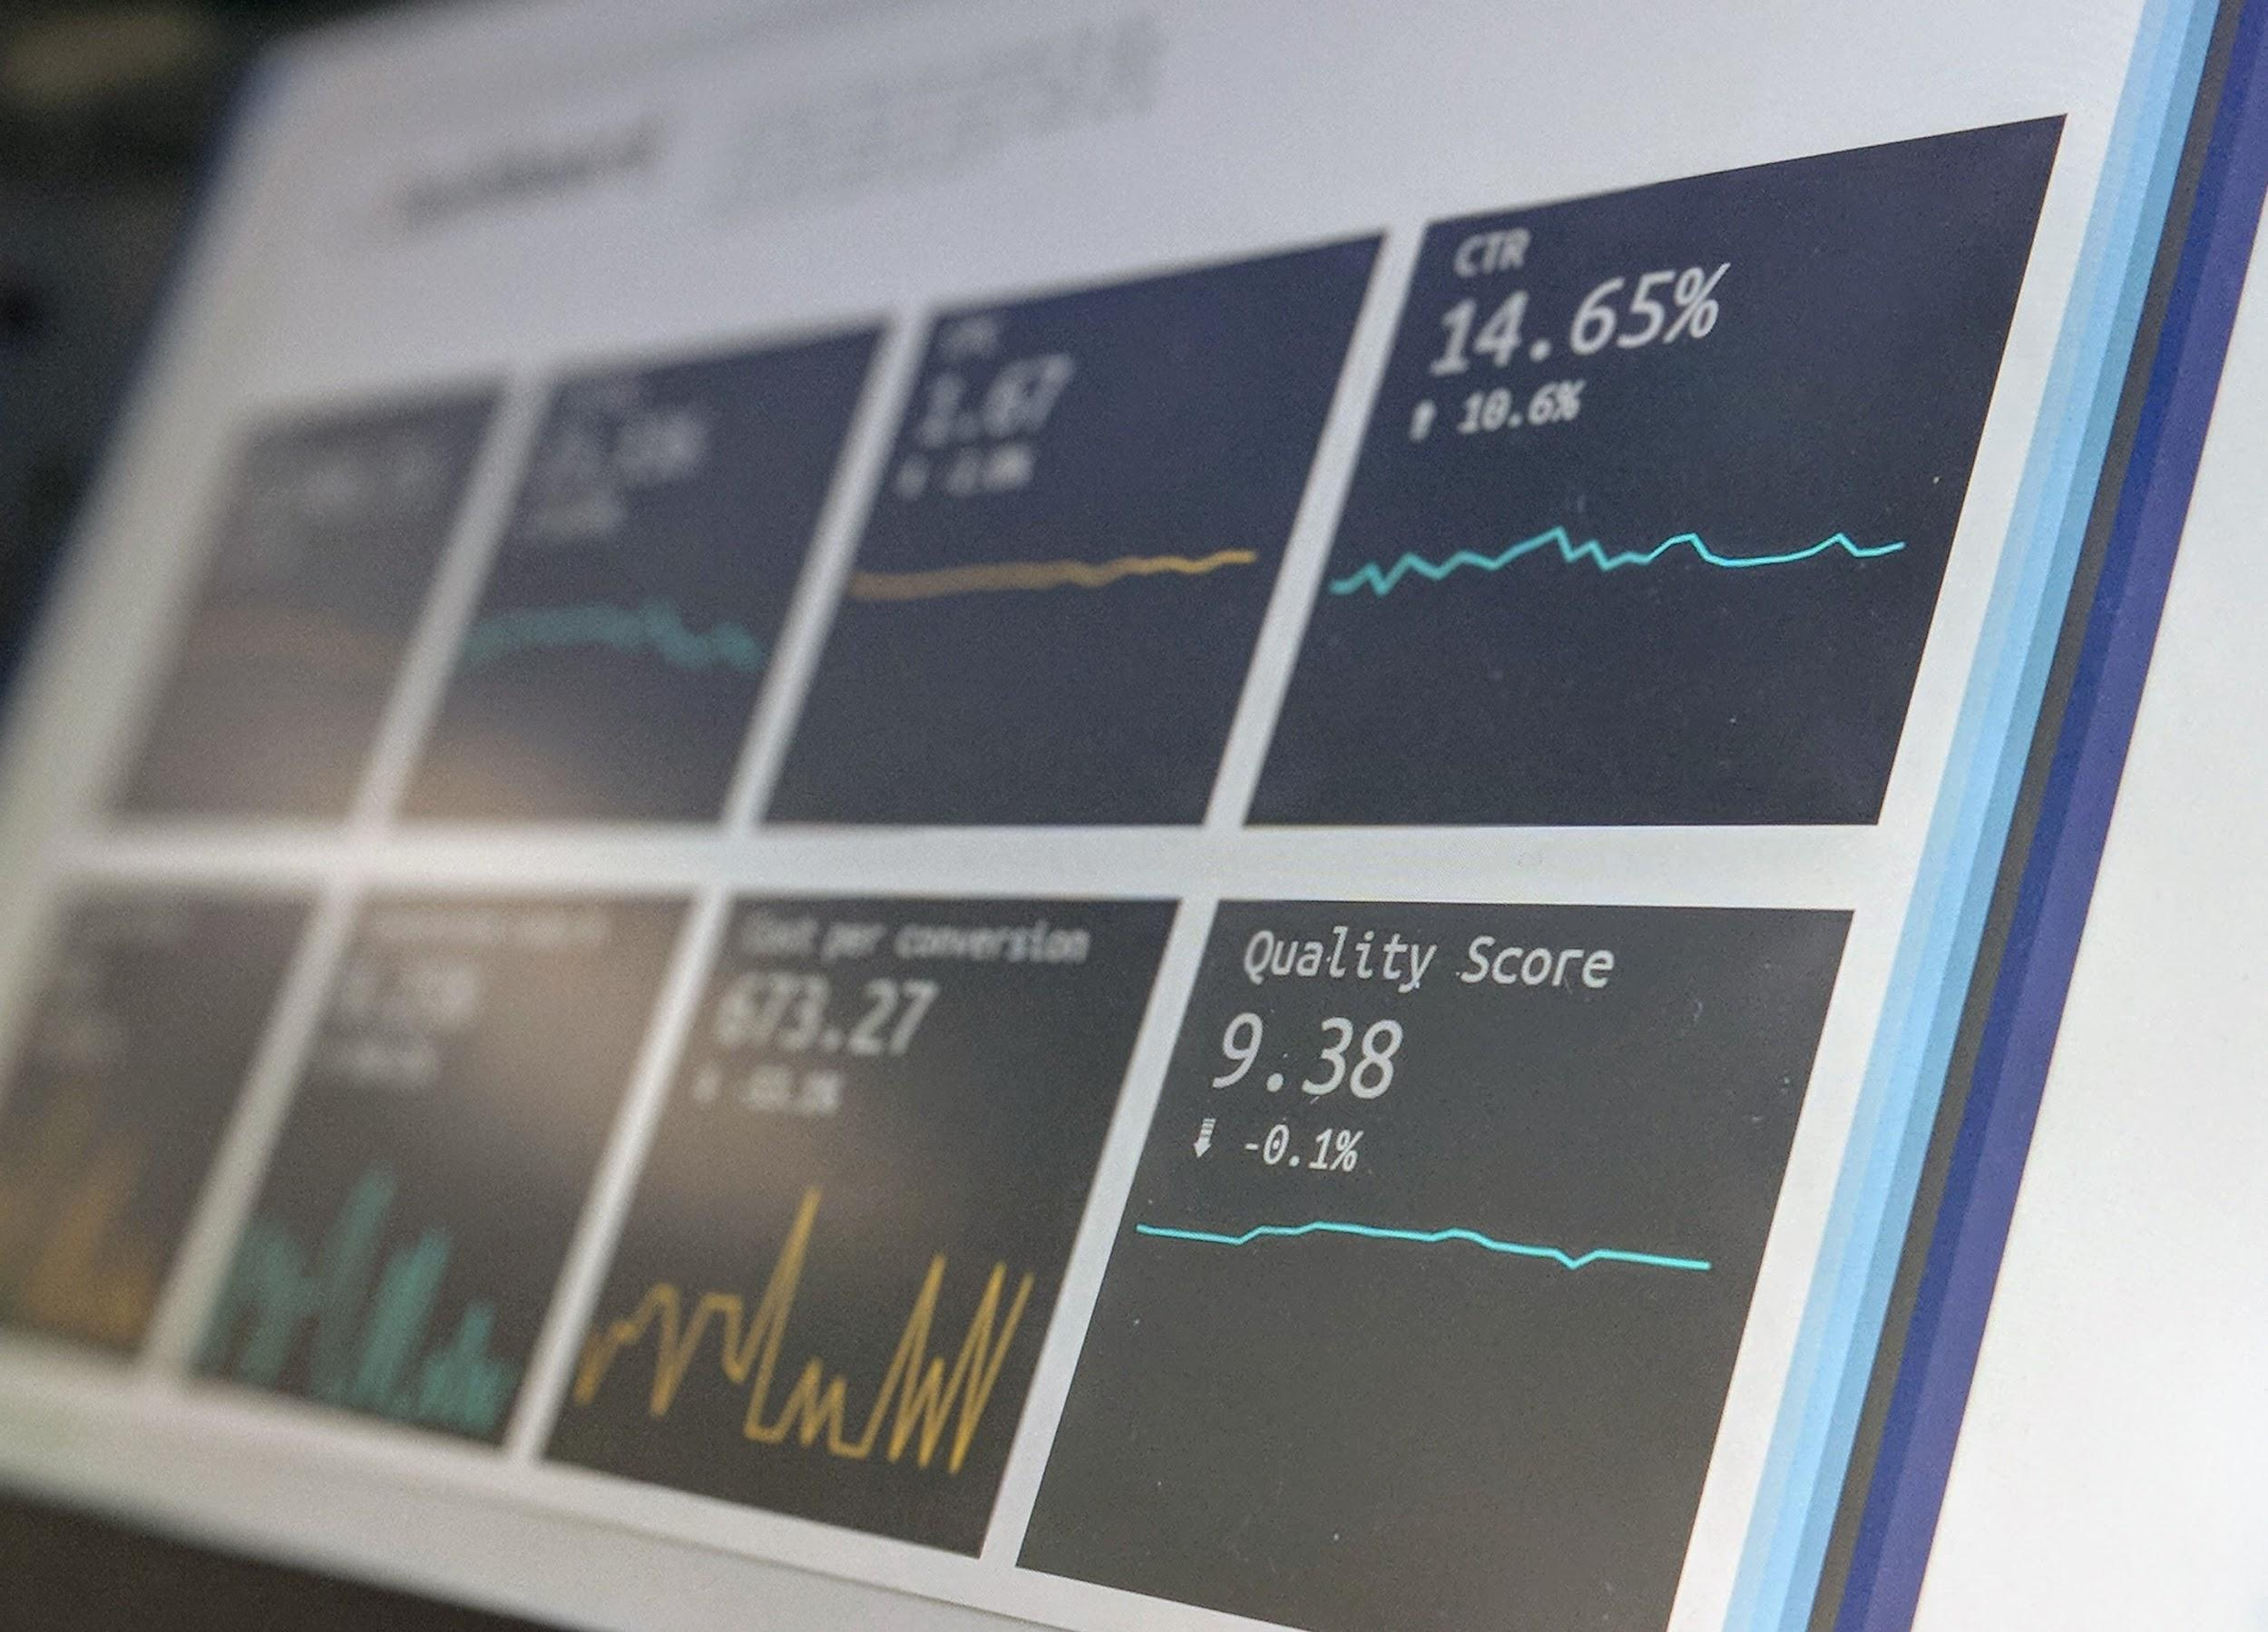
What to measure?
Facility policies/practices
Total & renewable energy use
Greenhouse gas emissions: Scopes 1, 2 and 3
Carbon intensity (CO2E per $ revenue)
Total water use
Non-hazardous waste - total, recycled, composted
Hazardous/toxic waste - including electronics - total, recycled, proper disposal
Purchasing practices
Photo by rawpixel on Unsplash
Photo by Stephen Dawson on Unsplash

Slide 9
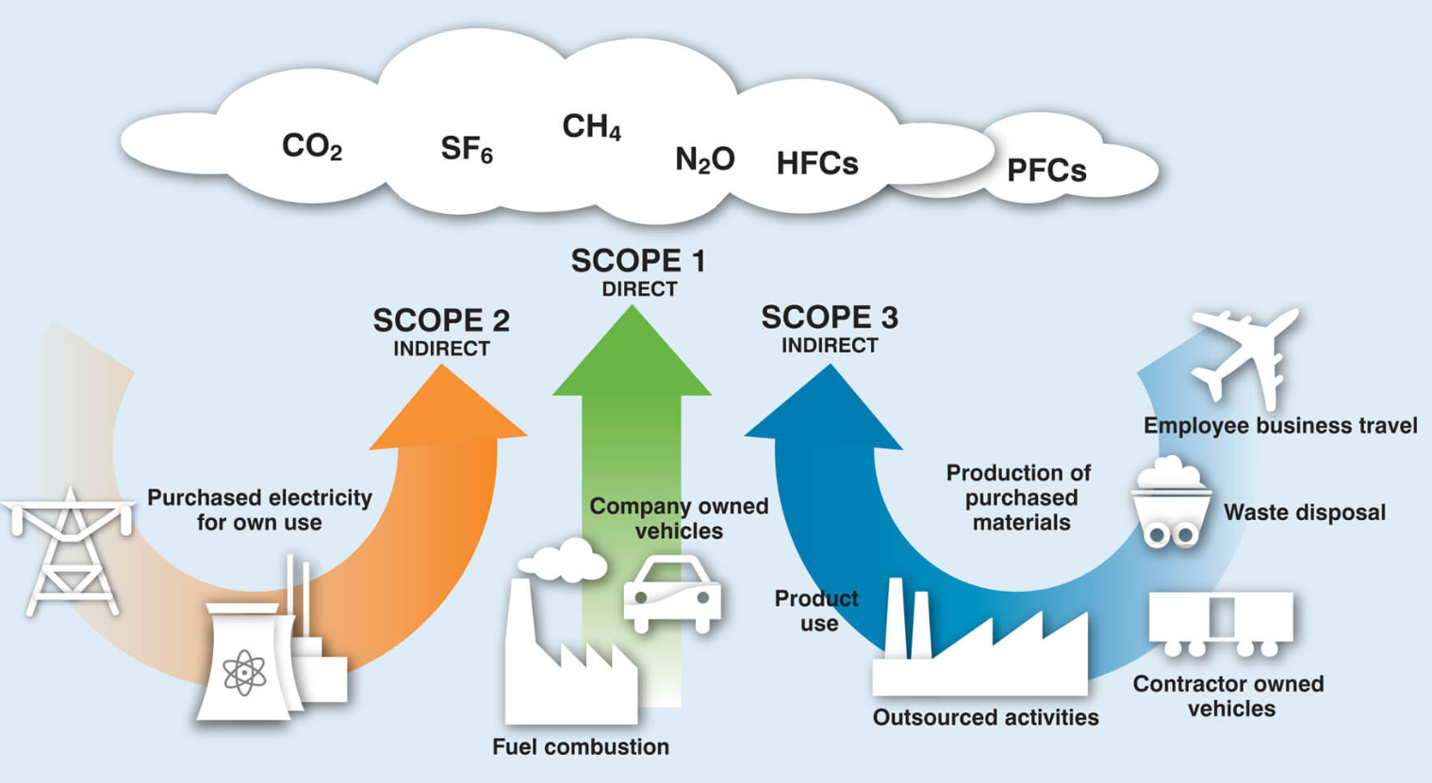
https://ghgprotocol.org/

Slide 10
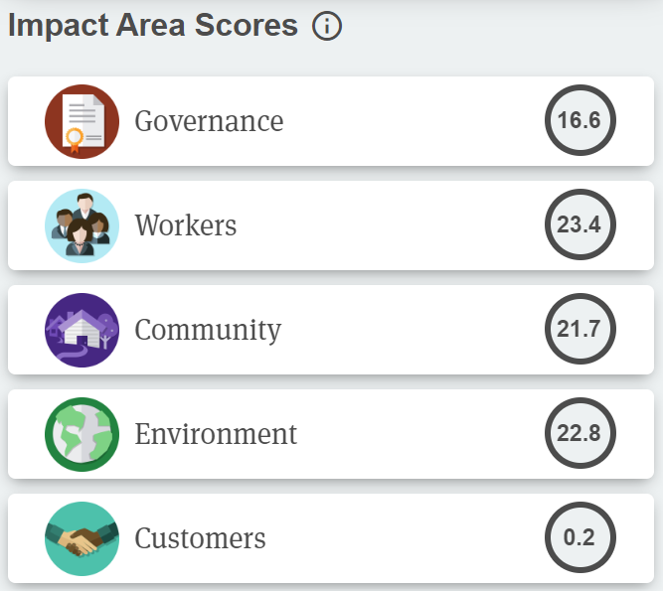
Reporting
B Impact Assessment
Global Reporting Initiative
CDP
TCFD
and more...
https://bcorporation.net/directory/danone-north-america

Slide 11
The business case for CSR
Innovate
Enhance
brand
Increase
revenue
Short term
Long term
Decrease
cost
Reduce
risk
Mitigate

Slide 12
Important work is already underway...
driving more sustainable ingredient sourcing, advancing packaging recyclability,
reducing waste,
conserving water,
ensuring animal welfare and
engaging our communities in these efforts.
http://www.danonenorthamerica.com/our-purpose/

Slide 13
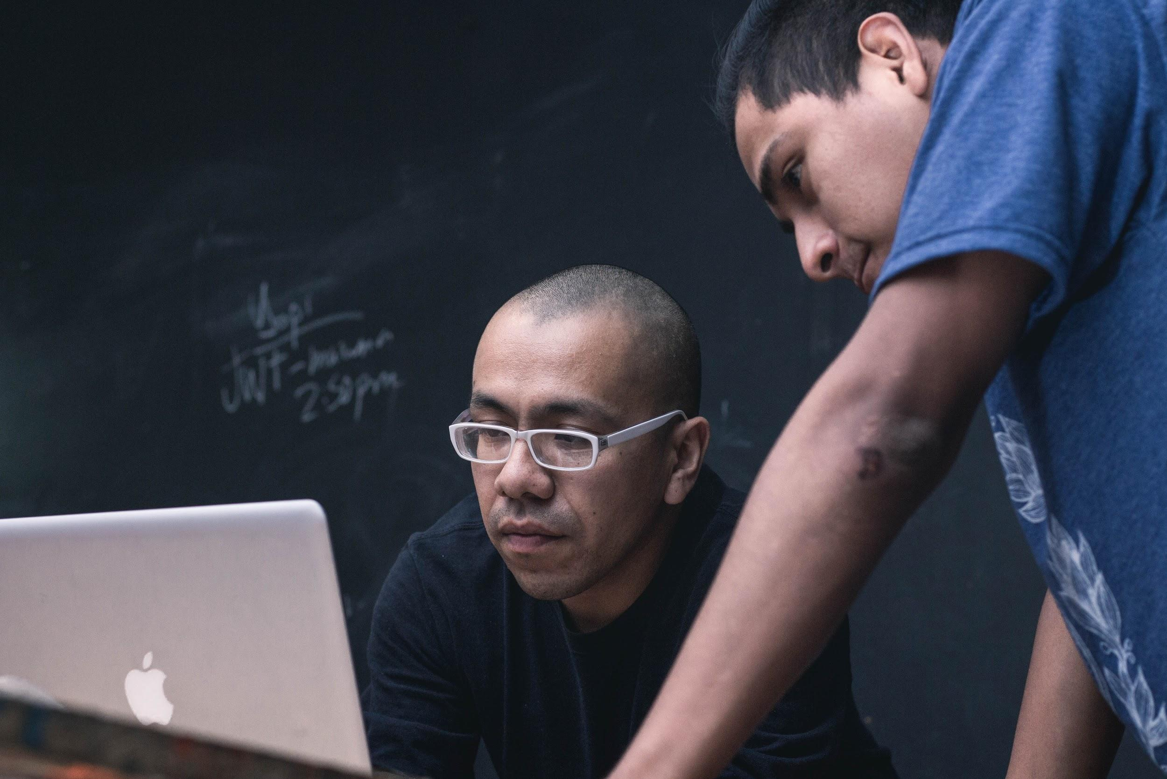
Necessary Allies
Top executives
Employees
Marketing
Customers/clients
Suppliers
NGOs
Photo by jose aljovin on Unsplash

Slide 14
Environmental Sustainability: Building Toward a Triple Bottom Line
Pete Dignan
petedignan@gmail.com
Mobile 303-507-2207
Notes:
Start my stopwatch/timer

