Slide 1
B:CIVIC
May 28, 2020

Slide 2
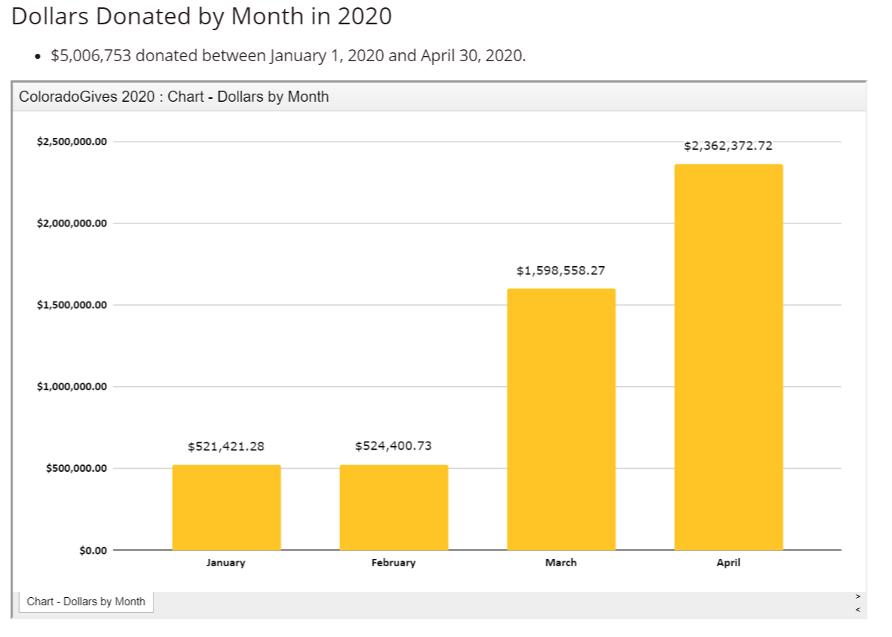
ColoradoGives Results

Slide 3
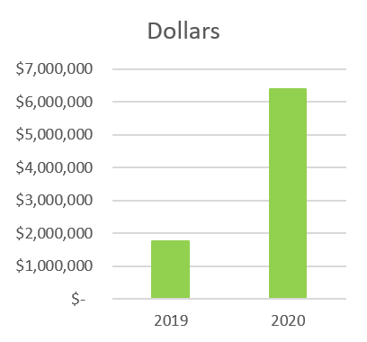
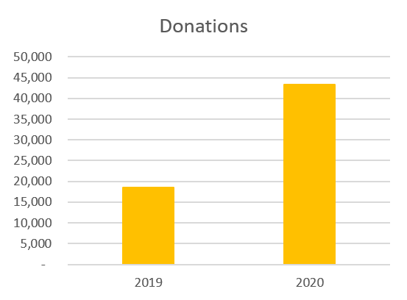
Using ColoradoGives – it works!

Slide 4
Notes:
On Tuesday, May 5, #GivingTuesdayNow brings the world together for an international day of giving and unity supporting the emergency response and unprecedented needs caused by COVID-19. To assist Colorado nonprofits wishing to participate, Community First Foundation is creating a customized marketing and promotional toolkit for Colorado nonprofits that you can use to promote your involvement in the event. It will be available April 15 at ColoradoGives.org #GivingTuesdayNow is not a replacement for Colorado Gives Day, but an additional opportunity for you to rally your donors during this exceptional time of need and support nonprofits in their efforts to encourage community healing from COVID-19.

Slide 5
GivingTuesdayNow Results
Total Dollars Donated: $1,361,395.02
Range of Donation Amounts: $10.00 - $15,306.12
Average Donation Amount: $142.23
Median Donation Amount: $51.02
Most Common Donation Amount: $102.40
Total Number Donations: 9,572
Total Number Donors: 5,566
Total Number Nonprofits to Receive a Donation: 1,338

Slide 6
GivingTuesdayNow Interesting Tidbits
There were donors from 49 of the 64 Colorado counties
There were donors from 46 of the 50 state
5,109 (92%) of donors were from Colorado
Most common donation amount is $102.04
82% of donors paid the 2% processing fee

Slide 7
GivingTuesdayNow Top 10 Types of Nonprofits
Primary Nonprofit Category | $ Raised
Human Services | $376,060.33
Education | $165,833.39
Arts, Culture & Humanities | $163,872.92
Animal-Related | $126,862.26
Food, Agriculture & Nutrition | $116,705.54
Youth Development | $56,036.93
Health Care | $51,548.41
Housing & Shelter | $50,248.55
Environment | $47,326.94
Mental Health & Crisis Intervention | $38,192.15

Slide 8
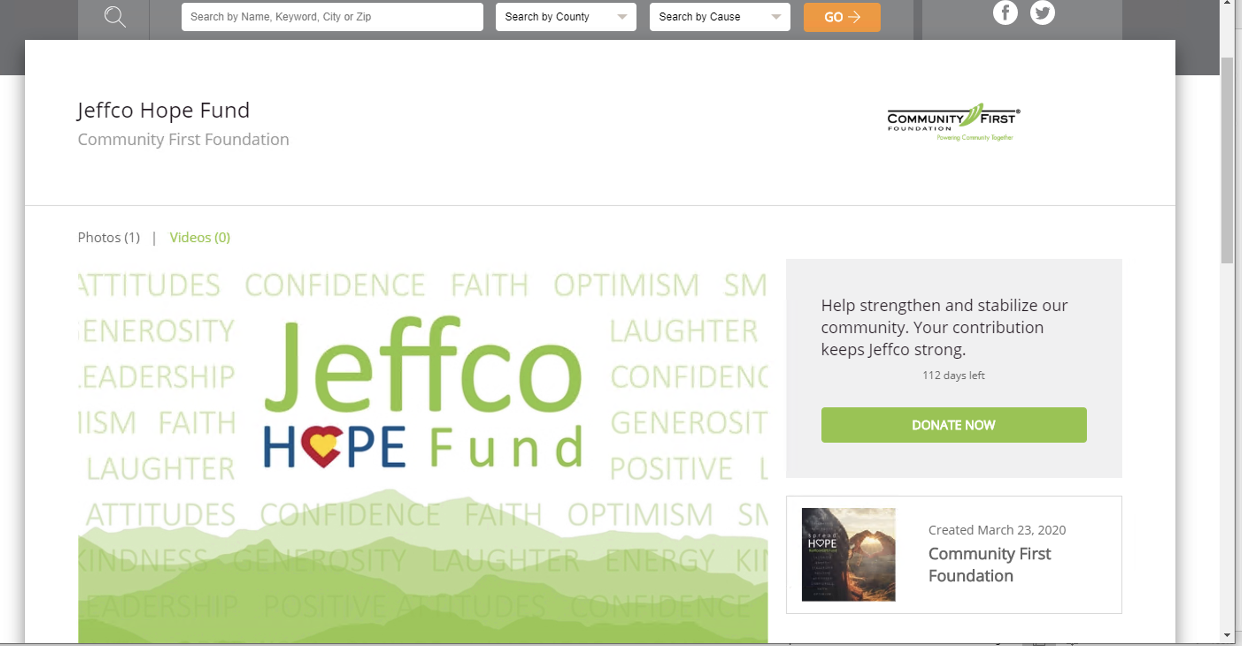
ColoradoGives Fundraising Pages

Slide 9
Jeffco Hope Fund – How to get Involved
Donate - www.coloradogives.org/JeffcoHope
C. Mandigo / M. Ortiz Cody Mandigo (5) Monique Ortiz (12)
C. Mandigo / M. Ortiz Cody Mandigo (5) Monique Ortiz (12)
Join the movement - #SpreadHopeCO

Slide 10
In Honor/In Memory

Slide 11
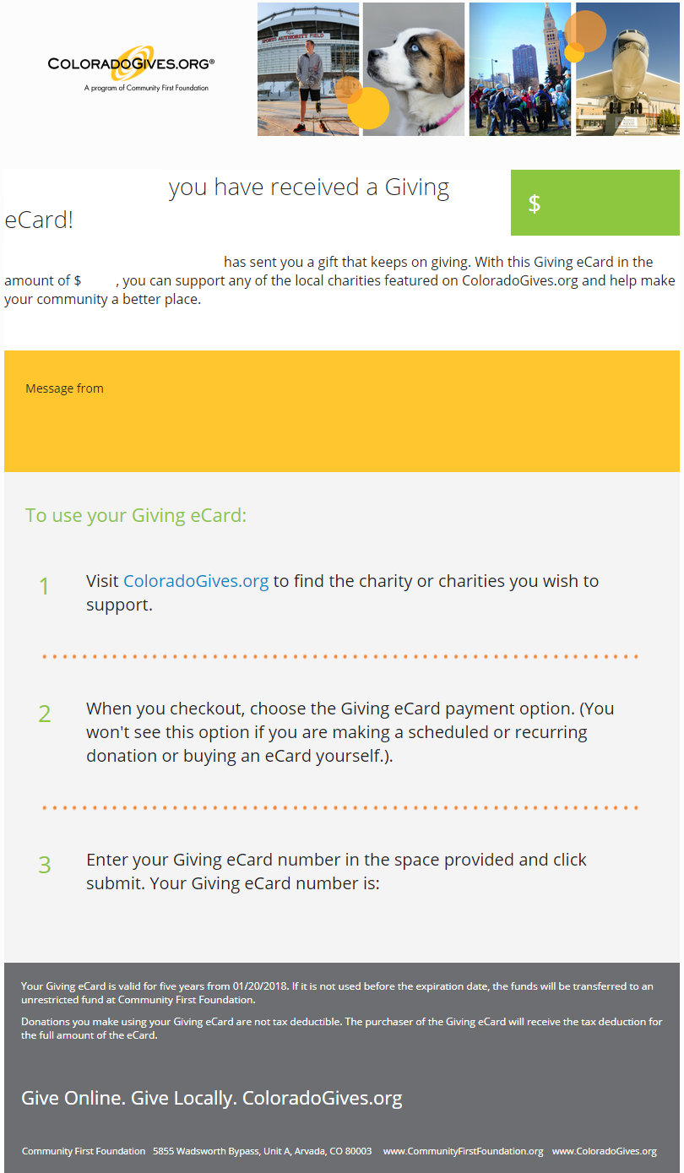
Giving eCards
Gift of giving
Purchaser gets tax deduction
Cultivate donor – they choose you
Notes:
Purchase card for family or friends and they can donate by picking a nonprofit on ColoradoGives. The purchaser actually makes the gift, but the recipient becomes your donor.

Slide 12
Statewide and Regional Opportunities

Slide 13
Local Community Foundation Opportunities
Community Foundation of Northern Colorado - https://www.coloradogives.org/NoCOVID-19
Community Foundation serving Southwest Colorado - https://www.coloradogives.org/cerf
Yampa Valley Community Foundation - https://yvcf.org/covid19/
The Denver Foundation: Critical Needs Fund
Community Foundation Boulder County: COVID-19 Response Fund Boulder County
Latino Community Foundation of Colorado: Ayuda Colorado Fund

Slide 14
Other Opportunities
Colorado Blueprint to End Hunger: Colorado COVID-19 Emergency Hunger Relief Fund
Denver Arts & Venues: Colorado Artist Relief Fund
El Pomar Foundation: Colorado Assistance Fund
Golden Civic Foundation: COVID-19 Community Response Fund
Ground Floor Media: COVID-19 Community Support Assistance for Smaller Colorado Nonprofits

Slide 15
Other Opportunities
No Kid Hungry: Coronavirus Grant Request
NextFifty Initiative: COVID-19 Response Fund
USDA Rural Development: Immediate Measures to Help Rural Residents, Businesses and Communities Affected by COVID-19
Vera and Joseph Dresner Foundation: COVID-19 Community Assistance Fund
Boettcher Foundation: COVID Biomedical Research Innovation Fund
The Women's Foundation of Colorado: Women and Families of CO Relief Fund

Slide 16
Thank you!

